Slide 1
Access Control List
Using a Network Simulator (e.g. packet tracer) Configure Router for.
b) Configure Access Control lists – Standard & Extended.

Slide 2
Introduction to ACL:
ACLs are basically a set of commands (rules), grouped together by a number or name that is used to filter traffic entering or leaving an interface (at Router).
When activating an ACL on an interface, you must specify in which direction the traffic should be filtered:
Inbound (as the traffic comes into an interface)
Outbound (before the traffic exits an interface)

Slide 3
Introduction to ACL:
Inbound ACLs:
Incoming packets are processed before they are routed to an outbound interface.
An inbound ACL is efficient because it saves the overhead of routing lookups if the packet will be discarded after it is denied by the filtering tests.
If the packet is permitted by the tests, it is processed for routing.
Outbound ACLs:
Incoming packets are routed to the outbound interface and then processed through the outbound ACL.

Slide 4
When you refer to a router, these terms have these meanings.
Out—Traffic that has already been through the router and leaves the interface. The source is where it has been, on the other side of the router, and the destination is where it goes.
In—Traffic that arrives on the interface and then goes through the router. The source is where it has been and the destination is where it goes, on the other side of the router.
Inbound —If the access list is inbound, when the router receives a packet, the Cisco IOS software checks the criteria statements of the access list for a match. If the packet is permitted, the software continues to process the packet. If the packet is denied, the software discards the packet.
Outbound—If the access list is outbound, after the software receives and routes a packet to the outbound interface, the software checks the criteria statements of the access list for a match. If the packet is permitted, the software transmits the packet. If the packet is denied, the software discards the packet

Slide 5
Universal fact about Access control list:
ACLs come in two varieties : Numbered and named
Each of these references to ACLs supports two types of filtering: standard and extended.
Standard IP ACLs can filter only on the source IP address inside a packet.
Whereas an extended IP ACLs can filter on the source and destination IP addresses in the packet.
There are two actions an ACL can take: permit or deny.
Statements are processed top-down.
Once a match is found, no further statements are processed—therefore, order is important.
If no match is found, the imaginary implicit deny statement at the end of the ACL drops the packet.
An ACL should have at least one permit statement; otherwise, all traffic will be dropped because of the hidden implicit deny statement at the end of every ACL.

Slide 6
ACL
NUMBERED
NAMED
STANDARD
EXTENDED
STANDARD
EXTENDED

Slide 7
Standard Access List | Extended Access List
Access List Range: IP Standard: 1-99 IP Standard Expanded Range: 1300 - 1999 2. Can Block a Host, Network and Subnet 3. Two way communication is stopped 4. All services are blocked 5. Implemented closest to the Destination 6. Filtering is done based on only source IP address | Access List Range: IP Extended: 100-199 IP Extended Expanded Range: 2000 - 2699 2. Can Block a Host, Network, Subnet and Service 3. One way communication is stopped 4. Selected service can be blocked 5. Implemented closest to the Source 6. It checks source, destination, protocol, port no

Slide 8
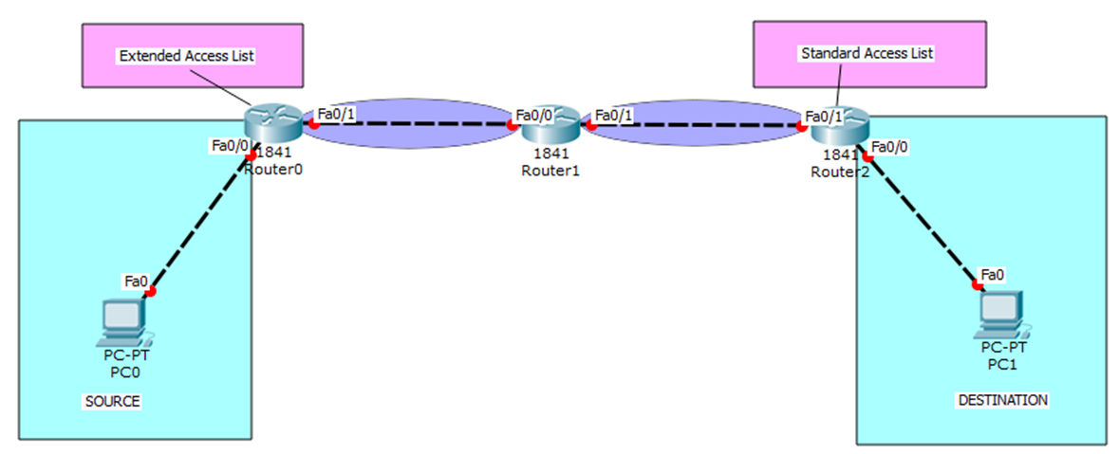
Placement of ACLs
Standard ACLs should be placed as close to the destination devices as possible.
Extended ACLs should be placed as close to the source devices as possible.

Slide 9
Standard ACLs:
A standard IP ACL is simple; it filters based on source address only. You can filter a source network or a source host, but you cannot filter based on the destination of a packet, the particular protocol being used such as the Transmission Control Protocol (TCP) or the User Datagram Protocol (UDP), or on the port number. You can permit or deny only source traffic.
Extended ACLs:
An extended ACL gives you much more power than just a standard ACL. Extended IP ACLs check both the source and destination packet addresses. They can also check for specific protocols, port numbers, and other parameters, which allow administrators more flexibility and control.

Slide 10
Named ACLs:
One of the disadvantages of using IP standard and IP extended ACLs is that you reference them by number, which is not too descriptive of its use. With a named ACL, this is not the case because you can name your ACL with a descriptive name. The ACL named Deny XYZ is a lot more meaningful than an ACL simply numbered 1.
Another advantage to named ACLs is that they allow you to remove individual lines out of an ACL. With numbered ACLs, you cannot delete individual statements. Instead, you will need to delete your existing access list and re-create the entire list.

Slide 11
ACL Configuration Guidelines
Order of statements is important: put the most restrictive statements at the top of the list and the least restrictive at the bottom.
ACL statements are processed top-down until a match is found, and then no more statements in the list are processed.
If no match is found in the ACL, the packet is dropped (implicit deny).
Each ACL needs either a unique number or a unique name.
The router cannot filter traffic that it, itself, originates.
You can have only one IP ACL applied to an interface in each direction (inbound and outbound)—you can't have two or more inbound or outbound ACLs applied to the same interface. (Actually, you can have one ACL for each protocol, like IP and IPX, applied to an interface in each direction.)
Applying an empty ACL to an interface permits all traffic by default: in order for an ACL to have an implicit deny statement, you need at least one actual permit or deny statement.
Remember the numbers you can use for IP
Wildcard mask is not a subnet mask. Like an IP address or a subnet mask, a wildcard mask is composed of 32 bits when doing the conversion; subtract each byte in the subnet mask from 255

Slide 12
There are two special types of wildcard masks:
0.0.0.0 and 255.255.255.255
A 0.0.0.0 wildcard mask is called a host mask
255.255.255.255. If you enter this, the router will cover the address and mask to the keyword any.

Slide 13
Standard Access Control List

Slide 14
Standard access list filters only traffic based on source traffic, all you need is the IP address of the host or subnet you want to permit or deny.
ACLs are created in global configuration mode and then applied on an interface.
The syntax for creating a standard ACL is :
access-list {1-99 | 1300-1999} {permit | deny} source-address [wildcard mask]
Three basic steps to configure Standard Access List:
Use the access-list global configuration command to create an entry in a standard ACL.
Use the interface configuration command to select an interface to which to apply the ACL.
Use the ip access-group interface configuration command to activate the existing ACL on an interface.

Slide 15
Standard ACL configuration for following :
Match a specific host
Match an entire subnet
Match an IP range
Match Everyone and anyone

Slide 16
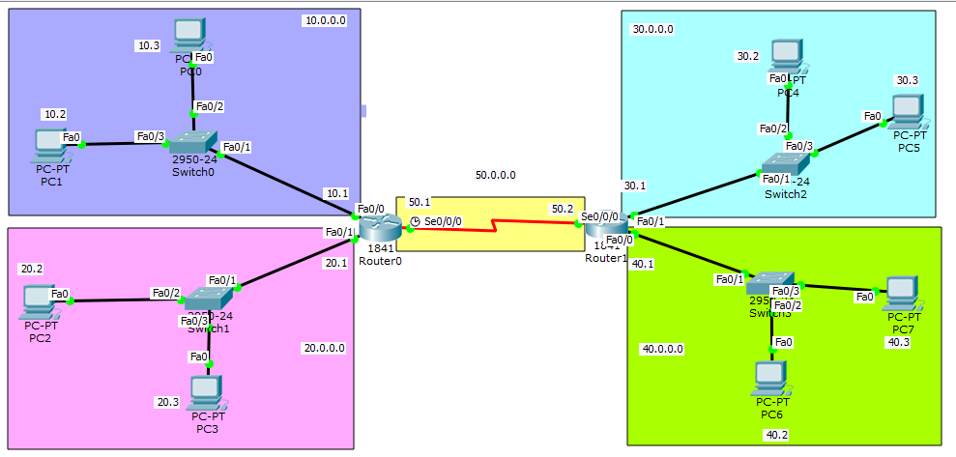
Network Created for ACL

Slide 17
1. Match specific hosts
Task
You have given a task to block 10.0.0.3 from gaining access on 40.0.0.0. While 10.0.0.3 must be able to communicate with networks. Other computer from the network of 10.0.0.0 must be able to connect with the network of 40.0.0.0.

Slide 18
Decide where to apply ACL and in which directions.
Our host must be able to communicate with other host except 40.0.0.0 so we will place this access list on FastEthernet 0/0 of Router 1 connected to the network of 40.0.0.0. Direction will be outside as packet will be filter while its leaving the interface. If you place this list on Router 0 then host 10.0.0.3 will not be able to communicate with any other hosts including 40.0.0.0.
R1>enable
R1#configure terminal
R1(config)#access-list 1 deny host 10.0.0.3
R1(config)#access-list 1 permit any
R1(config)#interface fastEthernet 0/0
R1(config-if)#ip access-group 1 out
R1>enable
R1#configure terminal
R1(config)#access-list 1 deny 10.0.0.3 0.0.0.0
R1(config)#access-list 1 permit any
R1(config)#interface fastEthernet 0/0
R1(config-if)#ip access-group 1 out

Slide 19
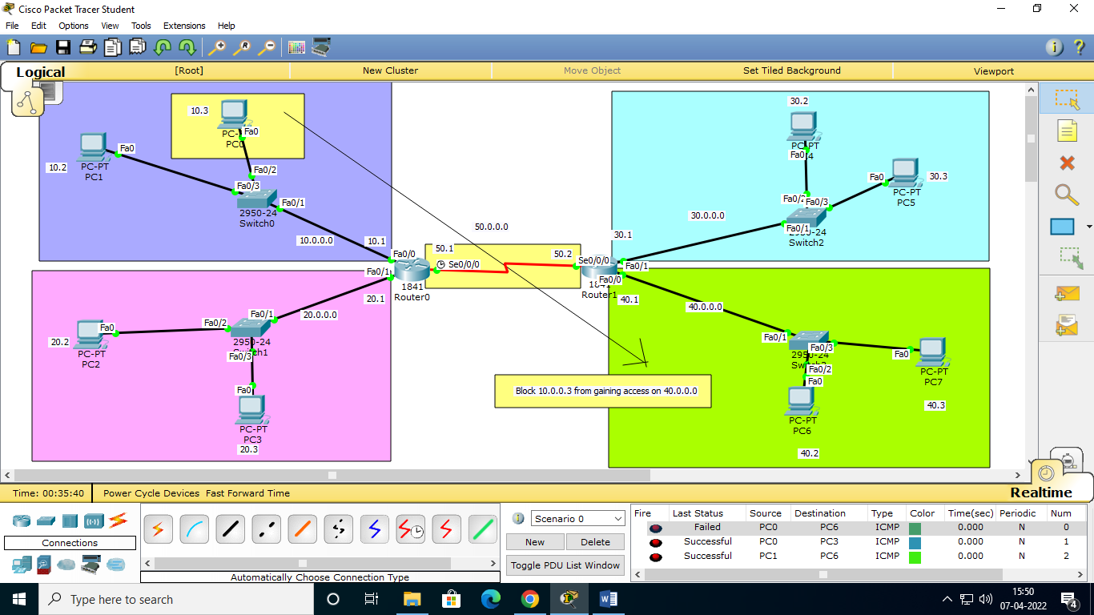

Slide 20
2. Match an entire subnet
Task
You have given a task to block the network of 10.0.0.0 from gaining access on 40.0.0.0. While 10.0.0.0 must be able to communicate with networks .
Wildcards
Wildcards are used with access lists to specify an individual host, a network, or a certain range of a network or networks.
Formula to calculate wild card mask for access list
The key to matching an entire subnet is to use the following formula for the wildcard mask. It goes as follows: Wildcard mask = 255.255.255.255 – subnet
So for example if my current subnet was 255.0.0.0, the mask would be 0.255.255.255.
255.255.255.255
255 .0 .0 .0 -
-----------------------
0. 255 .255.255

Slide 21
R1(config)#access-list 2 deny 10.0.0.0 0.255.255.255
R1(config)#access-list 2 permit any
R1(config)#interface fastethernet 0/0
R1(config-if)#ip access-group 2 out

Slide 22
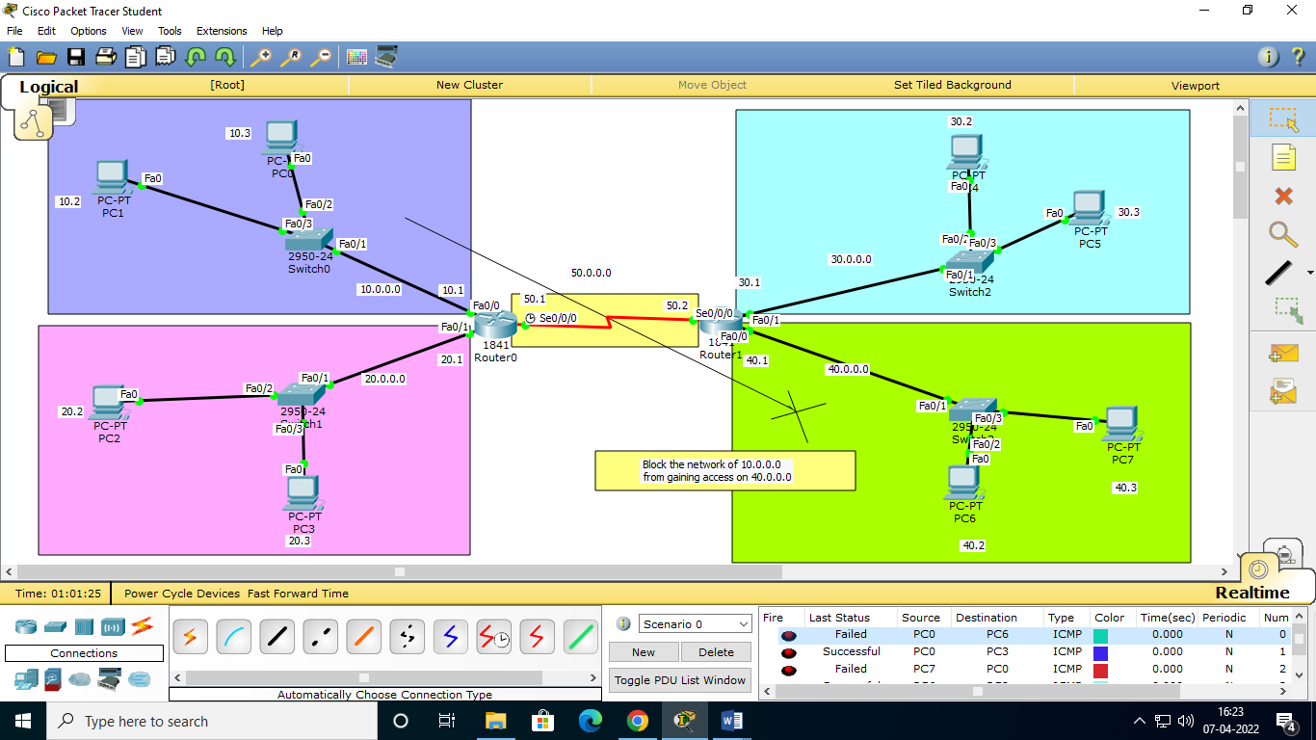

Slide 23
3. Match an IP range
Task
You are a network administrator at XYZ company You task is to block an ip range of 10.3.16.0 – 10.3.31.255 from gaining access to the network of 40.0.0.0
Solutions
Our range is 10.3.16.0 – 10.3.31.255. In order to find the mask, take the higher IP and subtract from it the lower IP.
10.3.31.255
10.3.16.0 -
--------------
0.0.15.255
In this case the wildcard mask for this range is 0.0.15.255.

Slide 24
R1>enable
R1(config)#access-list 2 deny 10.3.16.0 0.0.15.255
R1(config)#access-list 2 permit any
R1(config)#interface fastethernet 0/0
R1(config-if)#ip access-group 2 out
R1(config-if)#

Slide 25
4. Match Everyone and Anyone
This is the easiest of Access-Lists to create, just use the following:
access-list 1 permit any
or
access-list 1 permit 0.0.0.0 255.255.255.255

Slide 26
Extended Access Control List

Slide 27
An extended ACL gives you much more power than just a standard ACL.
Extended IP ACLs check both the source and destination packet addresses.
They can also check for specific protocols, port numbers, and other parameters, which allow administrators more flexibility and control.
The syntax for creating a standard ACL is :
access-list {100-199 | 2000-2699} {permit | deny} source-address [wildcard mask] destination-address [wildcard mask]
OR
access-list access-list-number {permit | deny} protocol source source-wildcard [operator port] destination destination-wildcard [operator port] [established] [log]

Slide 28
Extended ACL configuration for following :
Block host to host
Block host to network
Block Network to network
Block telnet access for critical resources of company
Limited ftp access for user
Stop exploring of private network form ping
Limited web access
Configure established keyword

Slide 29
Network Created for ACL

Slide 30
1. Block host to host
Task
You are the network administrator at XYZ Company. Your company hire a new employee and give him a pc 10.0.0.3. your company's critical record remain in 40.0.0.3. so you are asked to block the access of 40.0.0.3 from 10.0.0.3. while 10.0.0.3 must be able connect with other computers of network to perform his task.

Slide 31
Decide where to apply ACL and in which directions.
As we are configuring Extended access list. With extended access list we can filter the packed as soon as it generate. So we will place our access list on F0/0 of Router0 the nearest port of 10.0.0.3
R0>enable
R0#configure terminal
R0(config)#access-list 101 deny ip host 10.0.0.3 40.0.0.3 0.0.0.0
R0(config)#access-list 101 permit ip any any
R0(config)#interface fastEthernet 0/0
R0(config-if)#ip access-group 101 in

Slide 32
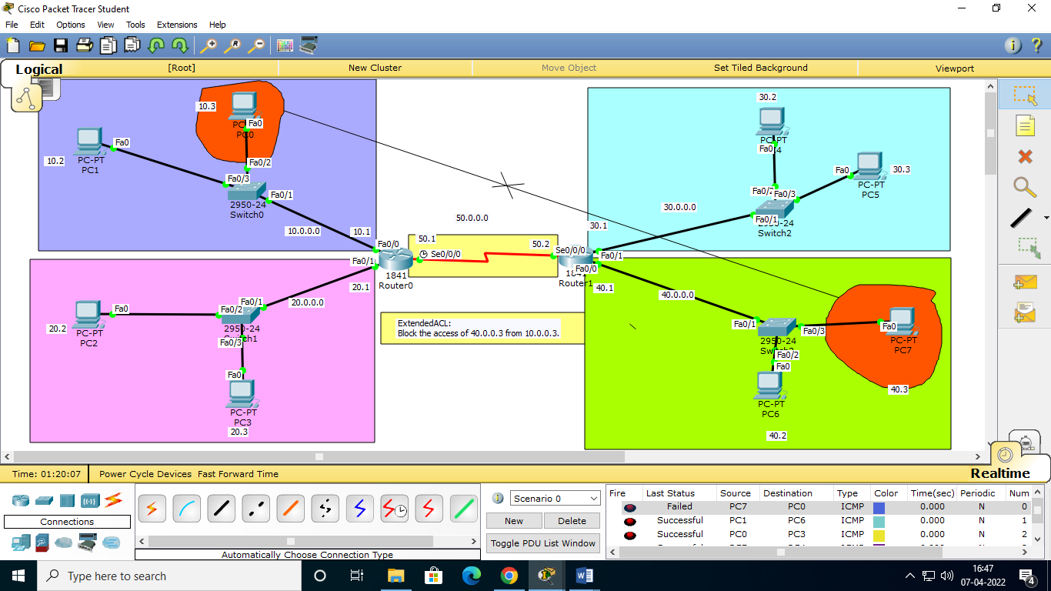

Slide 33
2. Block host to network
Task
Now we will block the 10.0.0.3 from gaining access on the network 40.0.0.0.
R0(config)#access-list 101 deny ip host 10.0.0.3 40.0.0.0 0.255.255.255
R0(config)#access-list 101 permit ip any any
R0(config)#interface fastEthernet 0/0
R0(config-if)#ip access-group 101 in

Slide 34
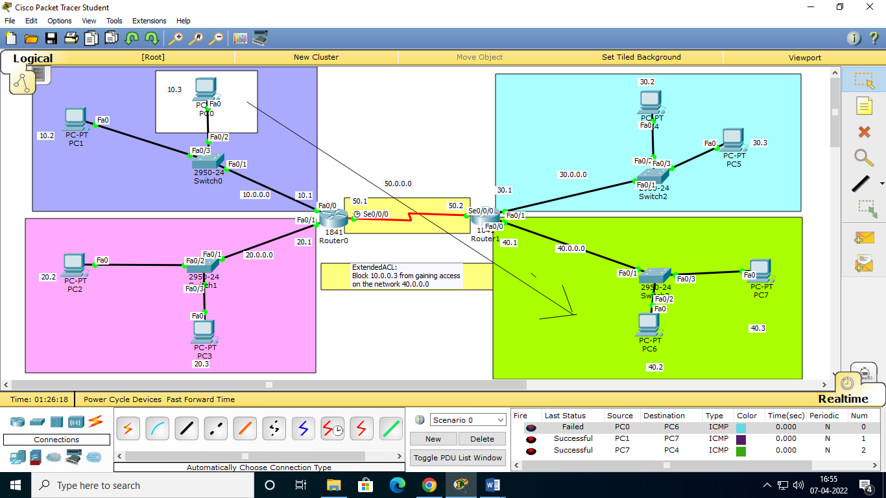

Slide 35
3. Network to Network Access List
Task
Student’s lab is configured on the network of 10.0.0.0. While management's system remain in the network of 40.0.0.0. You are asked to stop the lab system from gaining access in management systems
R0(config)#access-list 103 deny ip 10.0.0.0 0.255.255.255 40.0.0.0 0.255.255.255
R0(config)#access-list 103 permit ip any any
R0(config)#interface fastethernet 0/0
R0(config-if)#ip access-group 103 in
R0(config-if)#exit

